Slide 1

Cascading Style Sheets
Created by: Team 03
Akshai Krishna, Naveen Chowdhary, Madhan Kumar K, Karthick Kumar SM, Jashwanth E M

Slide 2
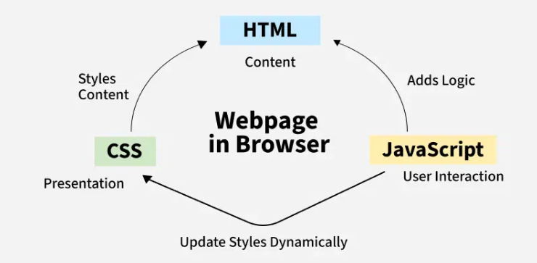
What is CSS
CSS (Cascading Style Sheets) is a stylesheet language used to describe the presentation of a document written in HTML or XML, including various XML languages like SVG and XHTML. CSS defines how elements should be rendered on screens or other media, playing a vital role in web development and design.

Slide 3
Origins and Development
Developer
World Wide Web Consortium (W3C)
Håkon Wium Lie and Bert Bos. Håkon Wium Lie first proposed the concept of CSS in 1994
To address the challenges of document presentation on the web, which was previously controlled solely by HTML.
Purpose
Separate the content of a document (HTML) from its presentation aspects (fonts, colors, layout).

Slide 4
Versions and Progresses Happening
Evolution
CSS1 (1996): Basic styling (text, fonts, box model).
CSS2 (1998): Advanced selectors, positioning, media types.
CSS 2.1 (2011): Fixed CSS2 issues, universal browser support.
CSS3: Modular updates (Flexbox, Grid, Animations, Media Queries).
Modern Features
Responsive Design: Media queries, container queries.
Advanced Layouts: Flexbox, Grid, Subgrid.
Visual Enhancements: Transitions, animations, transformations.
Ongoing Development
Continuous updates by W3C (custom properties, aspect-ratio).
Focus on flexibility and responsive design.

Slide 5
CSS Text: Styling Words, Creating Impact
CSS Text focuses on styling the appearance of text, including alignment, decoration, spacing, and effects like shadows or transformations.
Key CSS Text Properties
color: Change the text color (hex, RGB, named colors).
text-align: Align text (left, center, right, justify).
text-transform: Change case (uppercase, lowercase, capitalize).
text-decoration: Add underline, overline, line-through, or none.
letter-spacing & word-spacing: Adjust spacing between letters and words.
line-height: Control the space between lines for better readability.
Why Text Matters:
Readability
Aesthetic Appeal
Interactivity

Slide 6
The Power of CSS Fonts: More Than Just Text
CSS Fonts control the typeface, size, weight, and style of text, enabling customization of how text appears on the web.
Why CSS Fonts Matters
Brand Identity
Readability
Styling Impact
Key CSS Font Properties:
font-family: Choose the typeface (e.g., Arial, Georgia).
font-size: Control text size (px, em, rem).
font-style: Add emphasis (normal, italic, oblique).
font-weight: Adjust thickness (bold, light).
line-height: Improve readability (spacing between lines).
Sample Font Categories:
Serif: Classic and formal (e.g., Times New Roman).
Sans-serif: Clean and modern (e.g., Arial).
Monospace: Coding and technical (e.g., Courier New).

Slide 7
CSS Color & Background: Adding Life to Design
CSS Color defines the text, border, or background color of elements, using formats such as named colors, HEX, RGB, or HSL.
CSS Background customizes the background of an element with solid colors, gradients, images, and effects.
CSS Color Properties:
color: Sets the text color using named colors, HEX, RGB, HSL, or transparent.
opacity: Adjusts transparency of an element.
background-color: Fills the background with a solid color.
CSS Background Properties:
background-image: Adds images or gradients as the background.
background-size: Controls image scaling (cover, contain, custom size).
background-position: Positions the image (top, center, left, etc.).
background-repeat: Repeats or restricts the background image (no-repeat, repeat-x, repeat-y).

Slide 8
CSS Positioning: Control the Layout, Own the Space
CSS Positioning determines how elements are placed in relation to the document flow, other elements, or the viewport.
Key Positioning Properties:
static (Default): Elements are positioned naturally in the document flow.
relative: Positioned relative to its normal position.
absolute: Positioned relative to the nearest positioned ancestor.
fixed: Positioned relative to the viewport and doesn’t move with scrolling.
sticky: Toggles between relative and fixed based on the scroll position.
Supporting Properties:
top, right, bottom, left: Specify offsets for positioned elements.
z-index: Controls stacking order of overlapping elements.

Slide 9
Sizing the Web: Mastering CSS Dimensions
CSS Dimensions control the width, height, and size-related properties of elements, allowing precise adjustments for layout and responsiveness.
Dimension Properties:
width & height: Set the element's size (fixed or responsive).
max-width & max-height: Limit the maximum size.
min-width & min-height: Ensure a minimum size.
Units:
Absolute Units: Pixels (px), centimeters (cm), inches (in).
Relative Units: Percentages (%), em/rem (relative to font size), viewport (vw, vh).
Box Sizing:
box-sizing: Includes padding and border in width/height calculation (border-box) or excludes them (content-box).

Slide 10
CSS Box Model: The Building Blocks of Layout
The CSS Box Model describes how elements are structured on a webpage, consisting of content, padding, borders, and margins to control spacing and layout.
Key Components of the Box Model:
Content: The area where text or images are displayed.
Padding: Space between the content and the border (inside the element).
Border: The edge around the padding, defining the element’s boundary.
Margin: Space outside the border, creating distance between elements.
Box Sizing:
content-box (default): Width/height excludes padding and border.
border-box: Width/height includes padding and border.

Slide 11
CSS Selectors: Target with Precision
Combinators:
descendant (space): Targets elements nested inside another (e.g., div p).
> (Child): Targets direct children only (e.g., ul > li).
+ (Adjacent Sibling): Targets the next immediate sibling.
~ (General Sibling): Targets all siblings after a specific element.
Basic Selectors:
* (Universal): Targets all elements.
element (Type): Targets all instances of a specific element (e.g., h1).
#id: Targets an element with a specific id.
.class: Targets elements with a specific class.
Attribute Selectors:
[attribute]: Targets elements with an attribute.
[attribute="value"]: Targets elements with a specific attribute value.
Pseudo-Classes:
:hover: Targets an element when hovered.
:nth-child(n): Targets elements based on their position.
:focus, :checked: Style interactive states.

Slide 12
Types of CSS: Styling Your Way
Inline CSS:
Applied directly to an HTML element using the style attribute.
Best for quick, single-element styles.
Internal CSS:
Written inside a <style> tag within the HTML file.
Suitable for styling a single webpage.
External CSS:
Stored in a separate .css file and linked to HTML.
Ideal for scalable, multi-page websites.

Slide 13
CSS Frameworks: Simplifying Web Design
CSS Frameworks are pre-designed libraries of CSS styles, components, and utilities that streamline web development and ensure consistent, responsive designs.
Popular CSS design:
Bootstrap: Most popular, with responsive grid systems and ready-made components.
Tailwind CSS: Utility-first framework for highly customizable designs.

